Slide 1
Finding a better place in Scarborough, Toronto
IBM - Data Science Capstone Project
Made By: Kishor R Rao

Slide 2
Introduction
The purpose of this Project is to help people in exploring better facilities around their neighborhood.
It will help people making smart and efficient decision on selecting great neighborhood out of numbers of other neighborhoods in Scarborough, Toronto.
This Project aim to create an analysis of features for a people migrating to Scarborough to search a best neighborhood as a comparative analysis between neighborhoods.

Slide 3
Data
Data Link: https://en.wikipedia.org/wiki/List_of_postal_codes_of_Canada:_M
The data retrieved from Foursquare contained information of venues within a specified distance of the longitude and latitude of the postcodes. The information obtained per venue as follows:
1. Neighborhood
2. Neighborhood Latitude
3. Neighborhood Longitude
4. Venue
5. Name of the venue e.g. the name of a store or restaurant
6. Venue Latitude
7. Venue Longitude
8. Venue Category

Slide 4
Methodology
Clustering
Most common venues in the neighborhood using groups

Slide 5
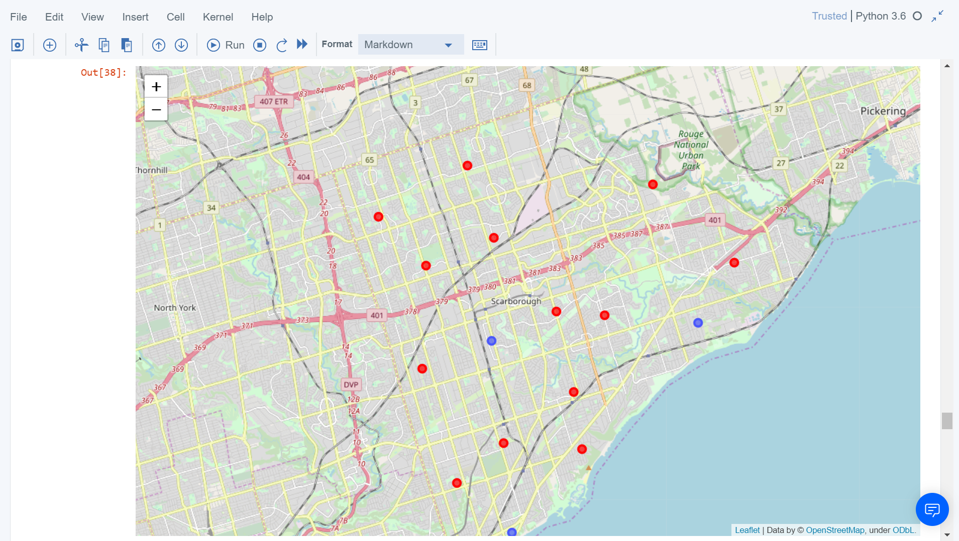
Results
Map

Slide 6
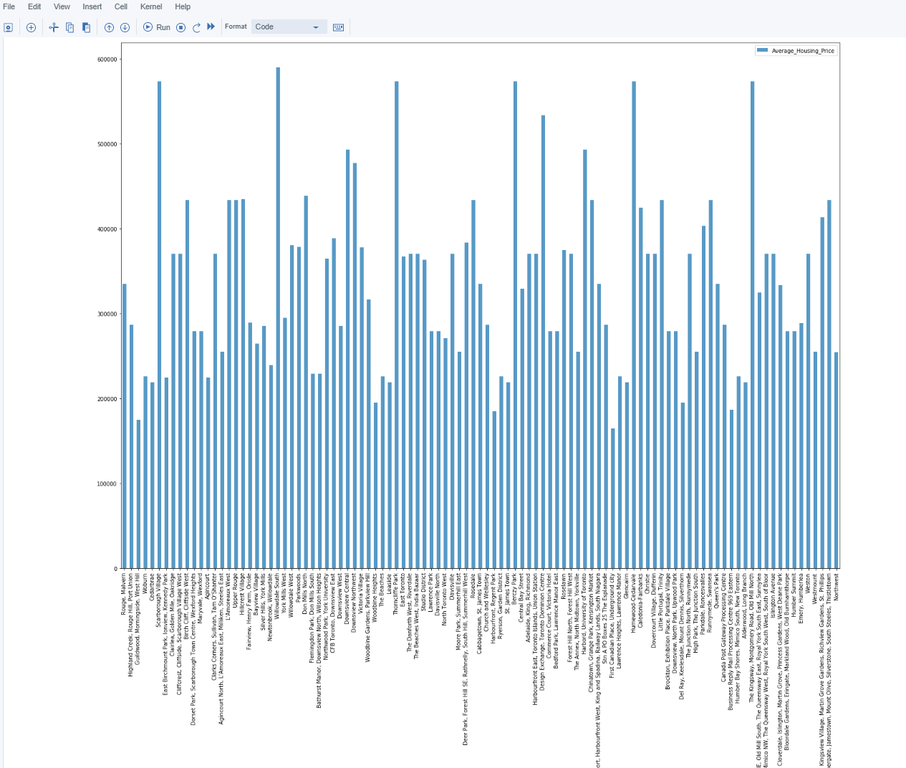
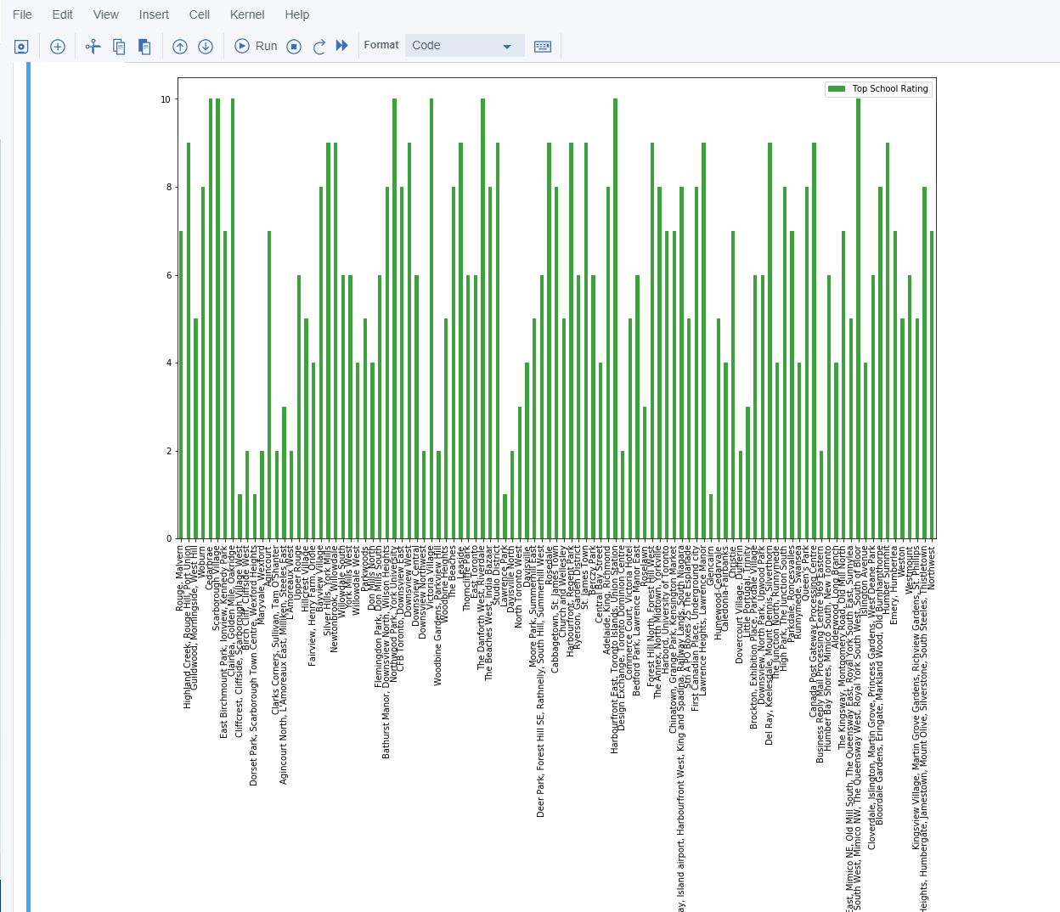
Average housing price and school ratings

Slide 7
Conclusion
In this project, using k-means cluster algorithm I separated the neighborhood into 10(Ten) different clusters and for 103 different latitudes and longitudes from dataset, which have very-similar neighborhoods around them.
Using the charts above results presented to a particular neighborhood based on average house prices and school rating have been made.

Slide 8
Thank You

